Slide 1

Rust System Programming vulnerabilities using ML and Static analysis tools
Yuktha Priya Masupalli

Slide 2
Agenda
Introduction to Rust and System Programming
Project Overview
Methodology
Static Analysis
Machine Learning
Data Processing
Key Findings
Challenges and Limitations
Future Work

Slide 3
Introduction
What is Rust?
A systems programming language focused on safety, performance, and concurrency
Memory safety without garbage collection
Widely used in systems programming (e.g., OS, browsers, blockchain)
Why Rust Security Matters
Rust's safety guarantees reduce vulnerabilities, but unsafe blocks and system-level operations introduce risks
Common vulnerabilities: buffer overflows, use-after-free, path traversal, etc.

Slide 4
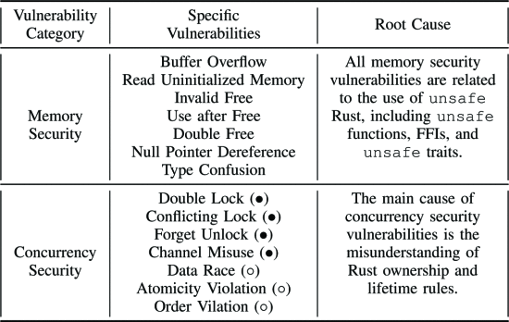
Rust Security Vulnerabilities Classification and Root Cause

Slide 5
Research Questions: Enhancing Rust Security Analysis
Can ML identify vulnerability patterns in Rust code effectively?
How can static analysis validate and refine ML-driven results?
Can a hybrid approach reduce false positives and improve accuracy?
How to improve the automation of finding vulnerabilities.

Slide 6

Project Overview
Objective: Detect vulnerabilities in Rust system programming code using a hybrid approach of machine learning (ML) and static analysis
Dataset:
50 safe and 50 unsafe Rust code snippets
Metadata: unsafe blocks, path traversal, command injection, function count, clippy warnings
Output: Security report (security_report.csv) detailing vulnerabilities
Tools:
Static Analysis: syn, regex for AST parsing and pattern matching
ML: Logistic Regression (linfa_logistic)
Others: walkdir, csv, tempfile

Slide 7

Experimental Method
Implemented data reading from CSV using the csv crate.
Trained and executed ML models (SVM, Logistic Regression, K-Means, XGBoost) using the linfa crate.
Generated a vulnerability report based on ML predictions.
Basic model evaluation implemented.
Used a limited synthetic CSV dataset for initial testing.

Slide 8

Methodology - Data Processing
Data Loader (data_loader.rs):
Processes 50 safe and 50 unsafe snippets
Creates temporary Cargo projects to run clippy for warnings
Generates metadata.csv with features and labels (safe/unsafe)
Vulnerability Detection (vuln_detector.rs):
Uses CodeFeatures from feature_extractor.rs
Produces SecurityReport with confidence score and list of vulnerabilities
Report Generation (main.rs):
Walks directory with walkdir to analyze all .rs files
Outputs security_report.csv with detailed vulnerability data

Slide 9
Methodology - Machine Learning
Purpose: Predict code safety based on extracted features
Model: Logistic Regression (linfa_logistic)
Training:
Dataset: metadata.csv (100 snippets, 5 features: unsafe blocks, path traversal, command injection, function count, clippy warnings)
Split: 80% training, 20% testing
Output: Trained model with accuracy printed
Implementation:
ml.rs: Loads dataset, trains model, computes accuracy
Features fed into model: numerical representation of code characteristics

Slide 10




Methodology - Static Analysis
Purpose:
Identify vulnerabilities through code structure and patterns
Process:
Key Components:
Parse Rust code into Abstract Syntax Tree (AST) using syn.
Detect patterns with regex.
Analyze for 30+ vulnerability types (e.g., buffer overflow, SQL injection)
static_analysis.rs: Defines CodeAnalysis struct, implements Security Visitor for AST traversal
feature_extractor.rs: Extracts features like unsafe blocks, raw pointers, and deprecated functions
vulnerability_detectors.rs: Generates LLVM IR for safe/unsafe code and detects unsafe patterns

Slide 11





Proposed Approach
Feature extraction from Rust code.
Training ML models for vulnerability classification.
Integrating static analysis tools (Clippy) for validation.
Generating a comprehensive vulnerability report.
Tools used: Rust language, linfa crate, ndarray crate, csv crate.

Slide 12
Prompt
You are a Rust programming expert tasked with generating pairs of Rust code snippets (safe and unsafe) that solve the same problem. For a given problem description, generate up to 50 distinct pairs of Rust code snippets. Each pair should consist of:
1. A "Safe Rust" snippet: This code should adhere to Rust's borrow checker rules and memory safety guarantees. It should be the idiomatic and recommended way to solve the problem in most scenarios. Clearly label this section as "Safe Rust:".
2. An "Unsafe Rust" snippet: This code should utilize `unsafe` blocks and demonstrate a way to solve the same problem by circumventing some of Rust's safety checks. Include a clear explanation within a comment block (`/* ... */`) detailing *why* the `unsafe` block is used, what safety invariants are being manually upheld, and the potential risks involved. Clearly label this section as "Unsafe Rust:".
Ensure that the safe and unsafe examples are semantically equivalent in their outcome for the given problem. The focus is on illustrating the difference in approach and the implications of using `unsafe`. Present each pair of safe and unsafe code snippets clearly separated. Example Problem: Incrementing a mutable static variable. Safe Rust: ```rust static mut COUNTER: usize = 0; fn increment_counter_safe() { // Accessing and modifying a mutable static is inherently unsafe. // This safe wrapper uses interior mutability via a Mutex to // provide safe access. use std::sync::Mutex; static COUNTER_MUTEX: Mutex<usize> = Mutex::new(0); let mut guard = COUNTER_MUTEX.lock().unwrap(); *guard += 1; } fn get_counter_safe() -> usize { use std::sync::Mutex; static COUNTER_MUTEX: Mutex<usize> = Mutex::new(0); *COUNTER_MUTEX.lock().unwrap() } fn main() { increment_counter_safe(); increment_counter_safe(); println!("Counter (safe): {}", get_counter_safe()); }”

Slide 13
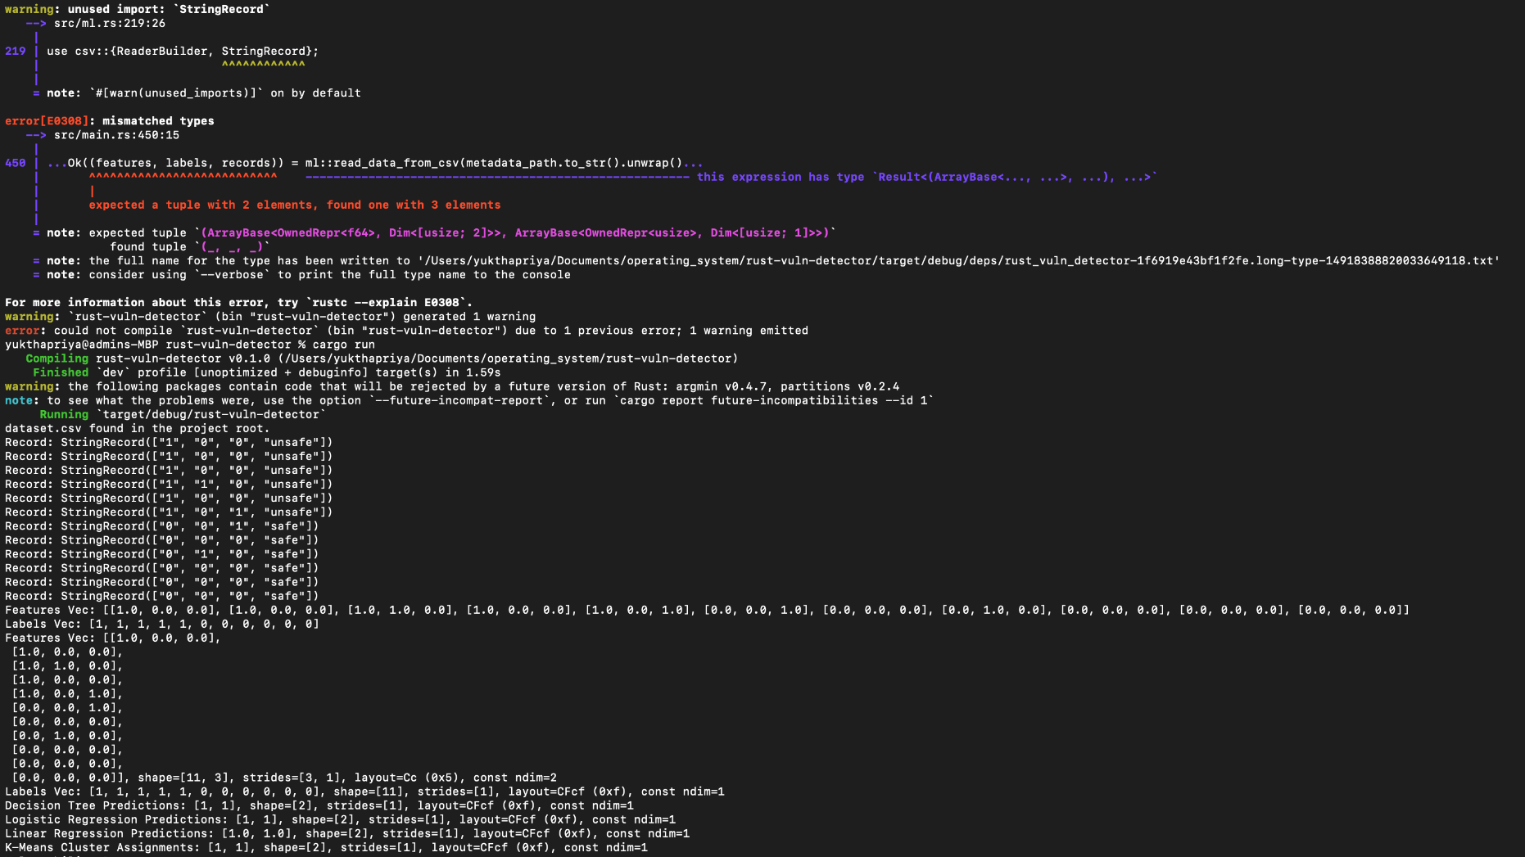

Slide 14
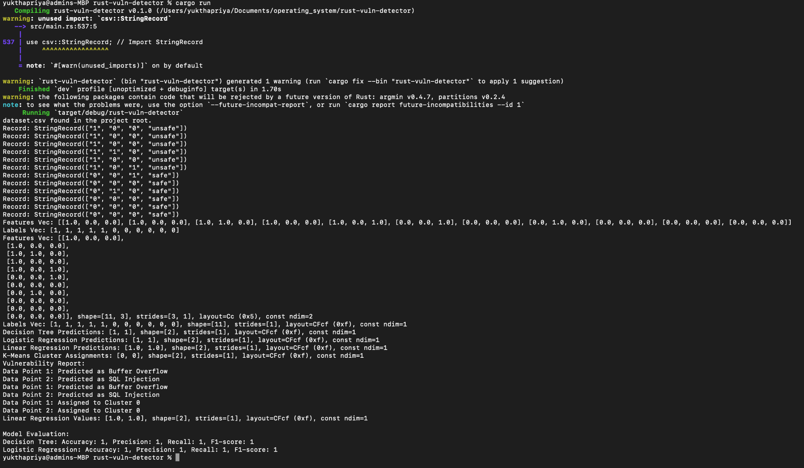

Slide 15
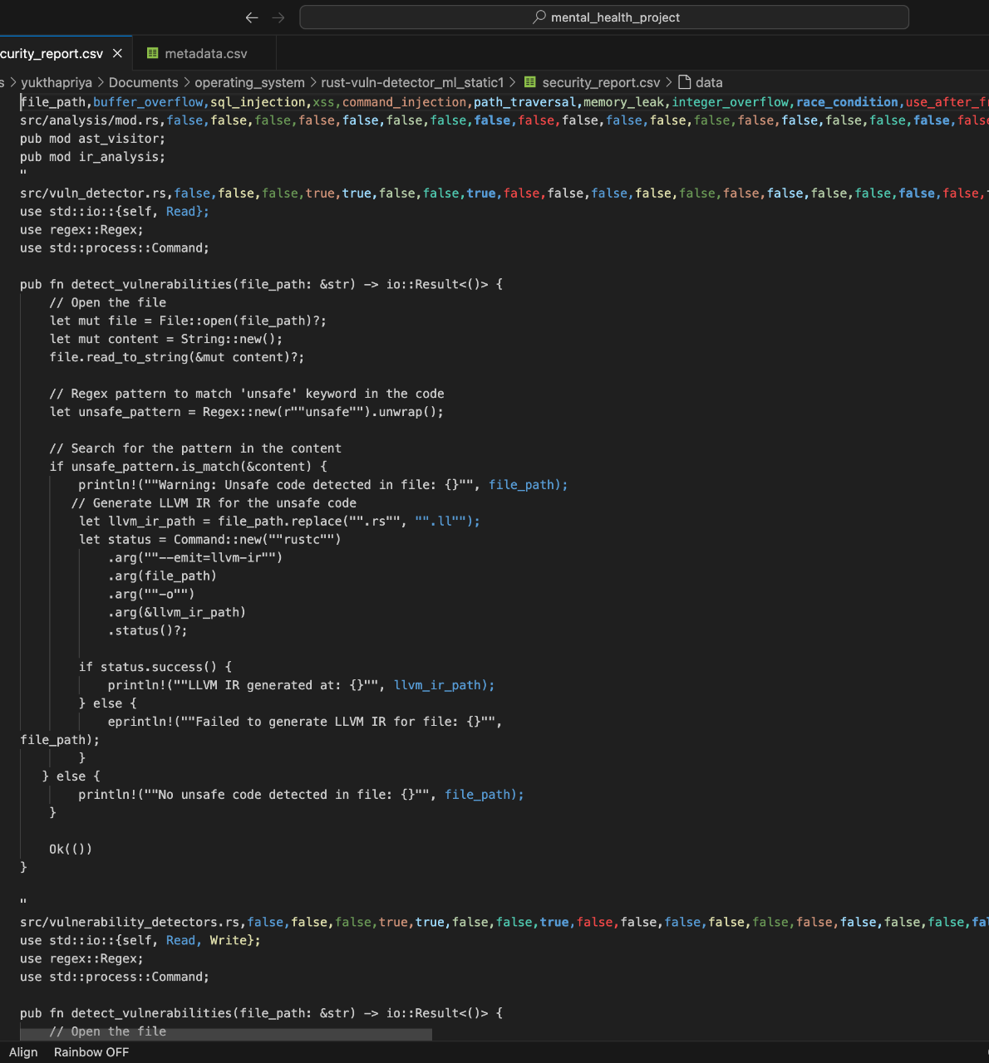
Report Generation
Output File: security_report.csv
Generated by vuln_detector.rs after analyzing Rust code
Stores vulnerability findings and confidence scores
Report Structure
Columns: File Path, Vulnerability Type, Confidence, Details
Example: unsafe_snippet_1.rs, Unsafe Block, 0.90, Unsafe block detected
Content
Vulnerabilities: Unsafe blocks, command injection, path traversal
Confidence: Derived from ML model (LogisticRegression) predictions
Details: Descriptive messages for each issue
Process
Static analysis (static_analysis.rs) extracts features
ML model (ml.rs) predicts vulnerability likelihood
Combined results written to CSV
Significance
Provides actionable insights for developers
Enables automated security audits of Rust codebases

Slide 16
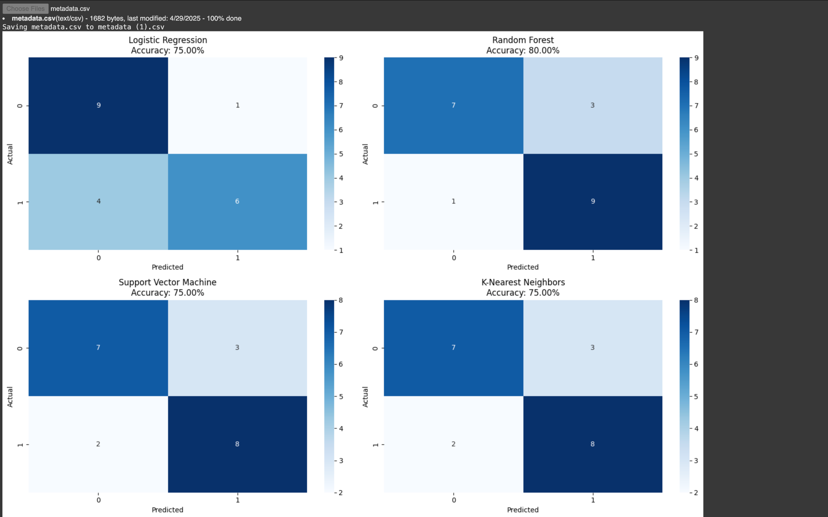
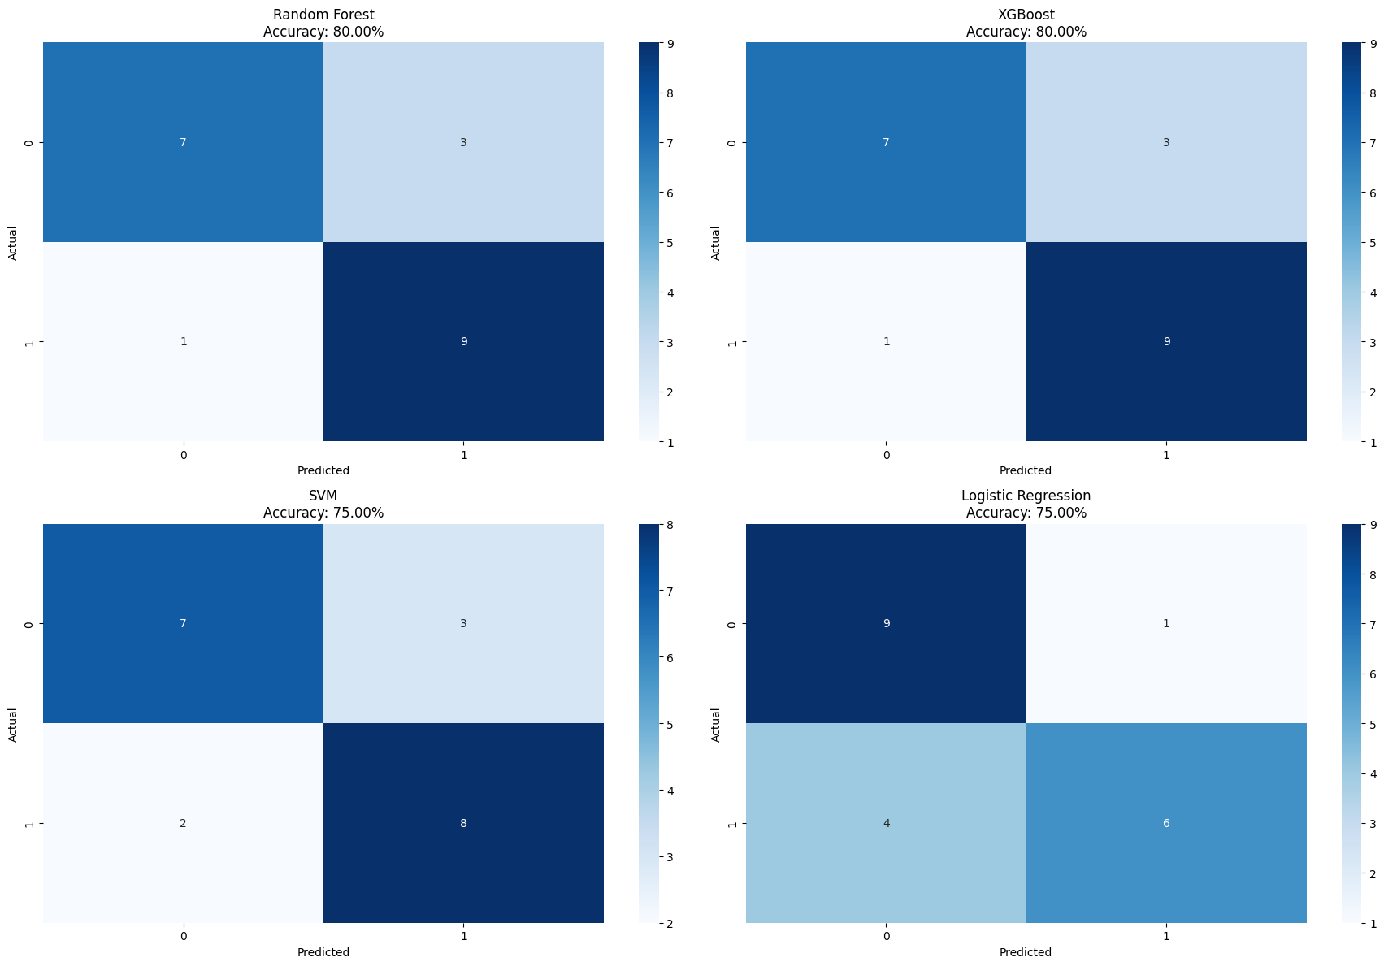
Confusion Matrix

Slide 17
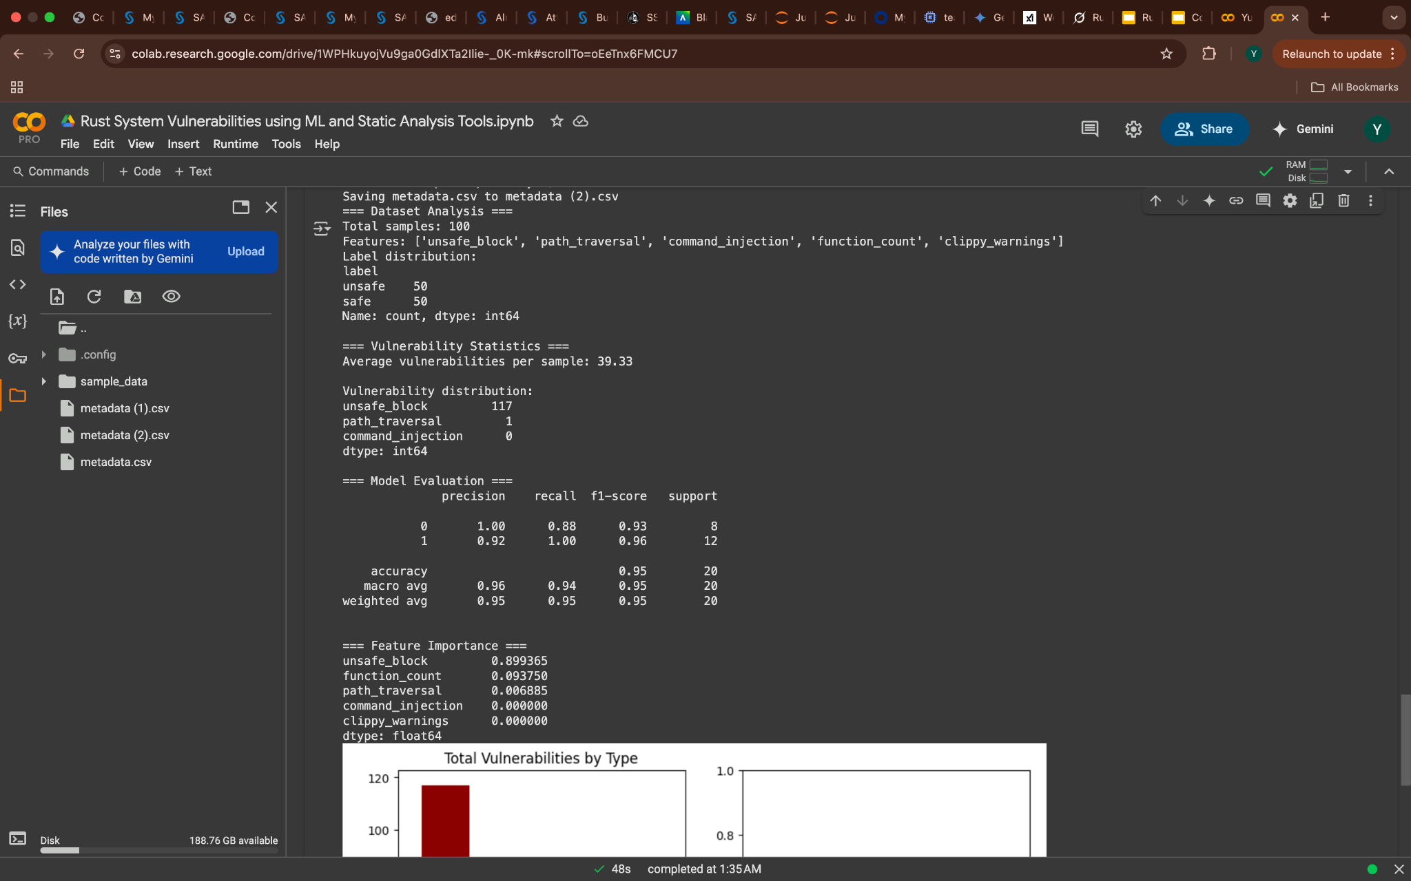
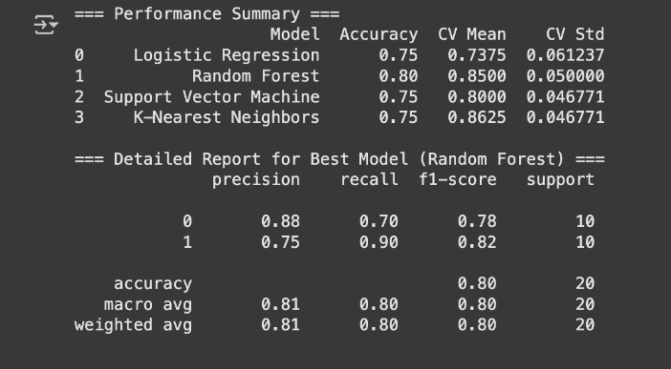
Performance Comparison

Slide 18
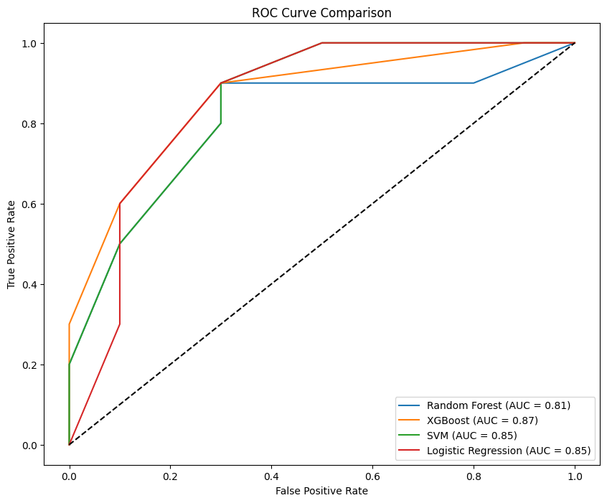
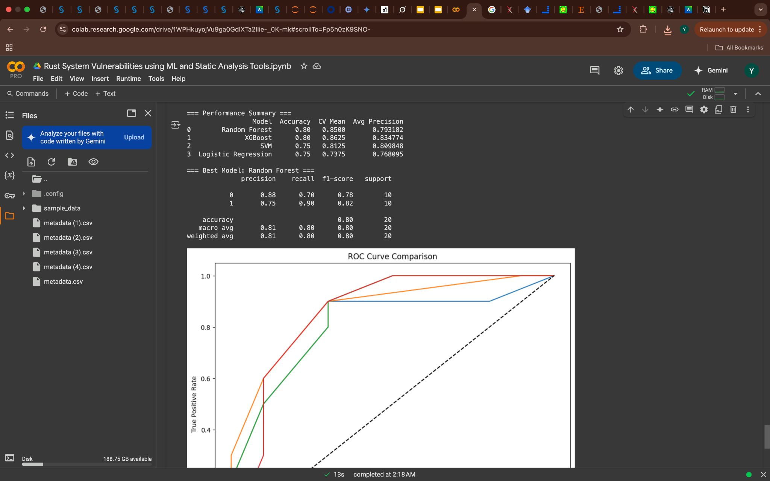
Comparison

Slide 19
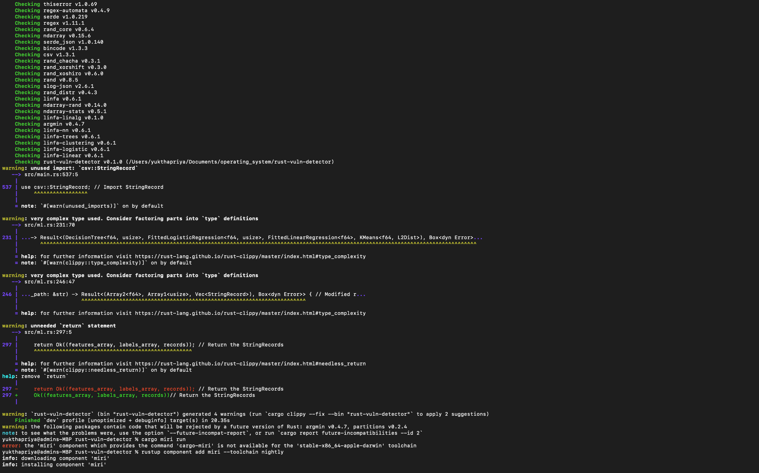
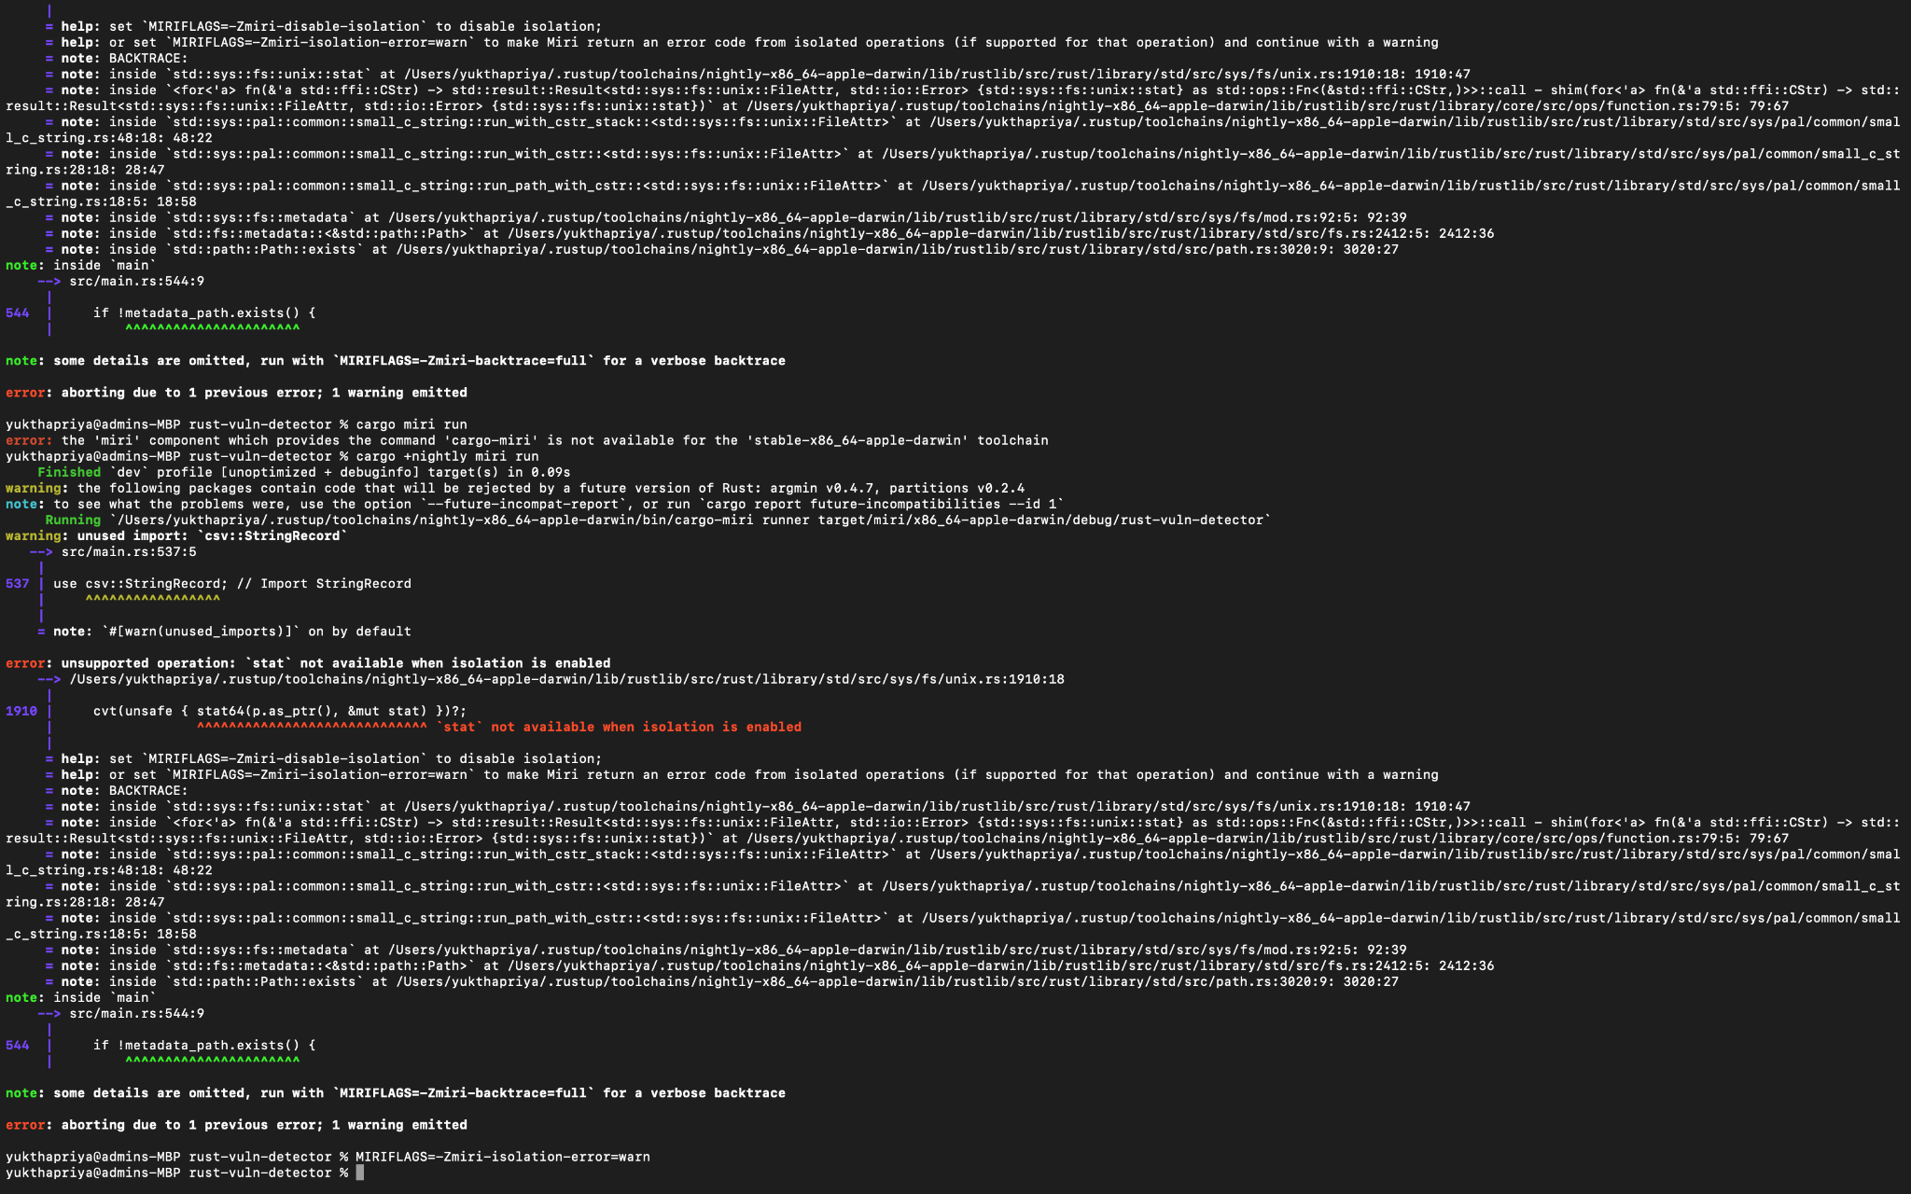
Clippy Miri

Slide 20
Challenges and Limitations
Challenges:
Limitations:
Limited dataset size (100 snippets)
Clippy warnings not fully integrated in static analysis (requires runtime)
Complex vulnerabilities hard to detect statically
False positives in regex-based detection (e.g., unwrap() in safe contexts)
ML model relies on limited features, may miss nuanced vulnerabilities
No dynamic analysis to catch runtime behaviors

Slide 21
Conclusion
1
2
3
Summary:
Developed a hybrid ML and static analysis tool for Rust vulnerability detection
Successfully identifies key system programming vulnerabilities
Generates detailed security reports for developers
Impact:
Enhances Rust code safety in critical systems
Provides a foundation for scalable security analysis
Next Steps:
Address limitations, expand dataset, and integrate with development workflows

Slide 22

Questions?

